Slide 1
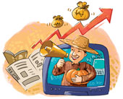
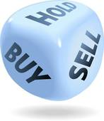
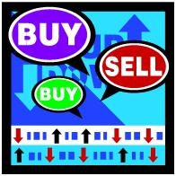
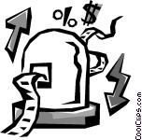


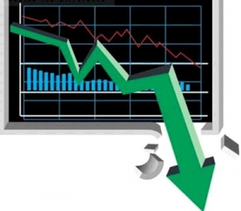
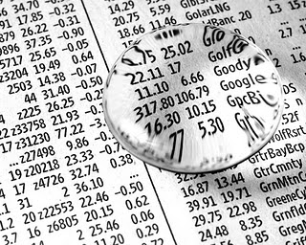
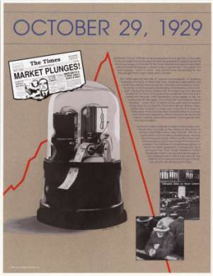
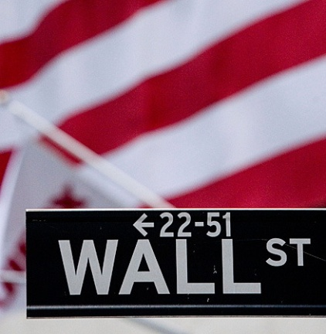
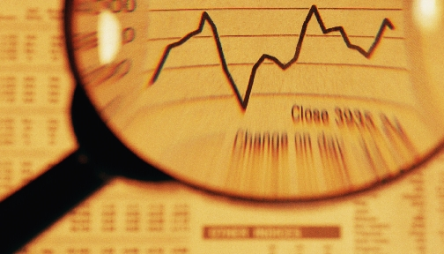
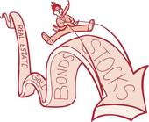

Slide 2
A statement will be read.
As a group, decide whether you believe the statement to be true or false.
Hold up the card to indicate your answer when prompted.
Each group will earn 5 points for each correct answer and lose 5 points for each incorrect answer.
Each group can choose to “double-down” on five questions. For every correct double down, the group will add 10 points to their score. For each incorrect answer, the group will subtract 10 points from their score.
A total of 100 points is a perfect score.

Slide 3
Stocks are items found in the storeroom of a grocery store.

Slide 4
FALSE
Stocks are shares of ownership of companies. These shares are sold to the public in markets around the world.

Slide 5

2. Only rich people invest in the stock market.

Slide 6
FALSE
Millions of people invest in the stock market through mutual funds, individual purchases of stock and pension investments.

Slide 7



3. Most stocks on the stock market are sold by the United States Government.

Slide 8
False
The United States Government does not sell stocks of private companies. These private company stocks are sold in stock markets.

Slide 9
4. If the stock market goes up 30% one year, it will fall by 30% in the next year.

Slide 10
False
The prices of stocks on the stock market change as the supply and demand for stocks change. They can change at any rate, or prices can stay the same for a long time. Over the long term, stocks have appreciated by 9%.

Slide 11
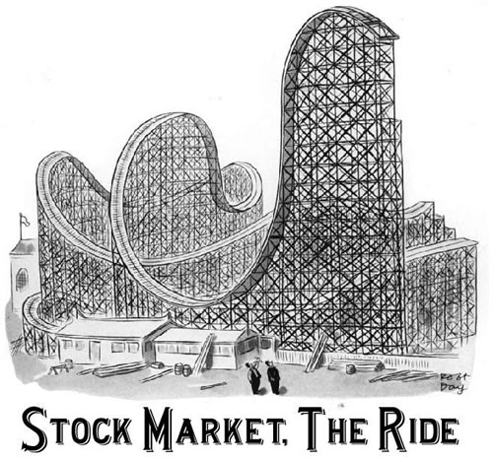
5. Any stock that goes up in price must eventually come back down.

Slide 12
False
Stock prices will usually not fall if the company remains successful and other investments do not become more attractive. Stock prices reflect the interest of investors. The law of gravity does not apply to stock prices.

Slide 13
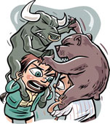
6. Bears, Bulls and Pigs are found in the stock market.

Slide 14
True
These names refer to people and their attitudes toward stock market performance.
Bulls are people who think the market will continue to rise. Bears think stock prices are very likely to fall. Pigs are people who try to make a big killing and tend to get “slaughtered” - in other words, they lose all their money on high-risk investments.

Slide 15

7. Stock prices are set by the Securities and Exchange Commission, a regulatory agency of the U.S. Government.

Slide 16
False
Stock prices are set by the supply and demand for stocks. The Securities and Exchange Commission regulates the stock markets to insure honest practices are followed and accurate information is provided to buyers and sellers of stock.

Slide 17

8. Stock markets are open on business days around the clock, around the world.

Slide 18
True
Stock markets exist in many different countries located in different time zones, so markets in Europe and Asia are open and in operation while U.S. citizens are sound asleep in their beds.

Slide 19
9. Sometimes companies buy their own stocks on the stock market.

Slide 20
True
A company for a variety of reasons may wish to have its stock price increase in value. One way a company might be able to increase the price of its stocks is by buying its own stock.

Slide 21
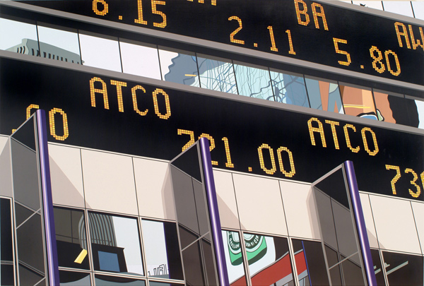
10. It is hard to buy a good stock today because all the good ones have already been purchased.

Slide 22
False
All “good” stocks are available for sale in large quantities. Just because someone currently owns them does not prevent investors from buying the stocks. The new investor just must offer a price attractive enough so current owners have an incentive to sell their stocks.

Slide 23
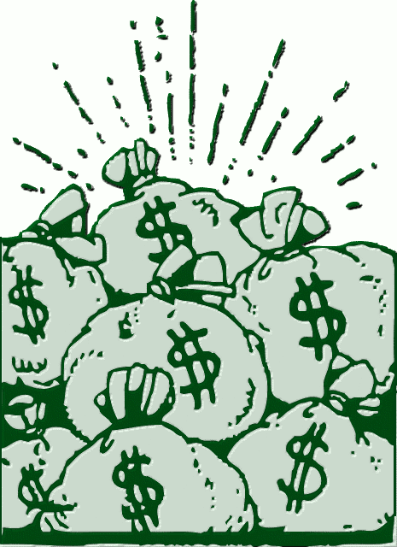
11. Buying stocks is a sure way to make money.

Slide 24
False
The prices of stocks rise and fall, depending upon economic conditions and business success. Many people have lost money by buying stocks when the prices were high and selling them after prices fell. There is risk in the stock market. It is not a sure way of making money.

Slide 25
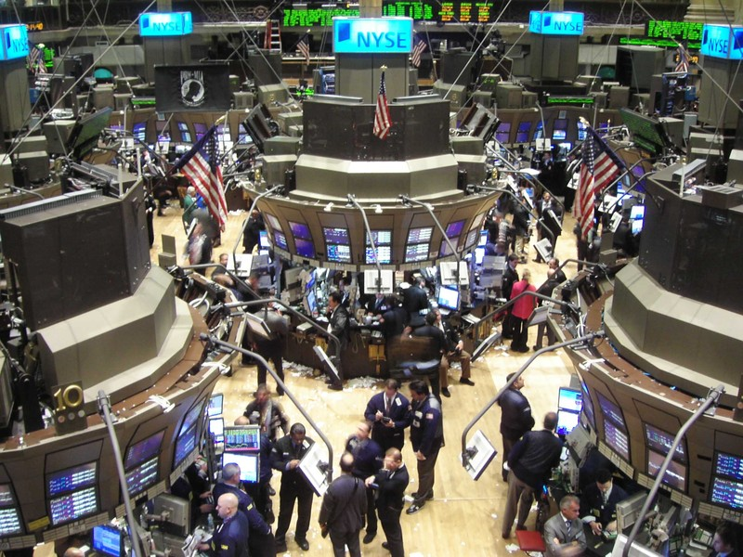
12. Corporations sell new issues of stock on the New York Stock Exchange.

Slide 26
False
New issues of stock are purchased by investment bankers (primary market) who will offer stocks to be resold to the public (secondary market).

Slide 27
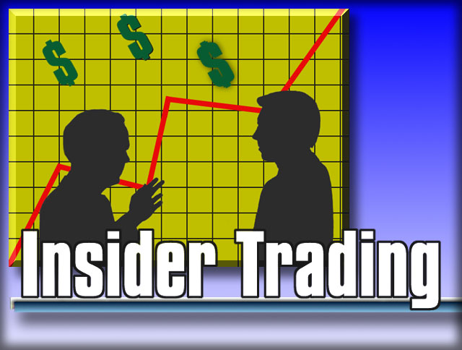
13. “Insider” stock trading means that trading stocks take place inside a building.

Slide 28
False
“Insider” stock trading refers to the illegal practice of people related to a company who find out important information about a company that will affect the stock price and buy or sell the stock before the information is made available to the general public.
An “insider” may be an accountant who knows that a company’s profits are greater than anticipated by the public because that accountant just finished preparing the accounting report for the company. If that accountant buys stocks before the report is made, she or he could buy the stock at a lower price than what other buyers will have to pay after the report is made public.

Slide 29

14. People can buy stocks on the Internet.

Slide 30
True
Many electronic methods exist that allow people to buy stocks without talking directly to a person.

Slide 31
15. When the stock market goes up, it causes the economy to grow.

Slide 32
False
The stock market is a very small part of the economy. It cannot cause the economy to grow or decline. It is one leading indicator of the economy, so when the stock market goes up it does signal that many people think the economy will grow in the near future. Sometimes they are right, and sometimes they are wrong.
From “Why Study the Stock Market? “, National Council on Economic Education, New York, NY

Slide 33

Examine Your Score:
75 -100 Market Analyst
50-74 Market Novice
50 or less Market Challenged

Slide 34
PowerPoint adapted from:
Lesson 1: Why Study the Stock Market?
Learning from the Market
National Council on Economic Education, 2006

